Slide 1
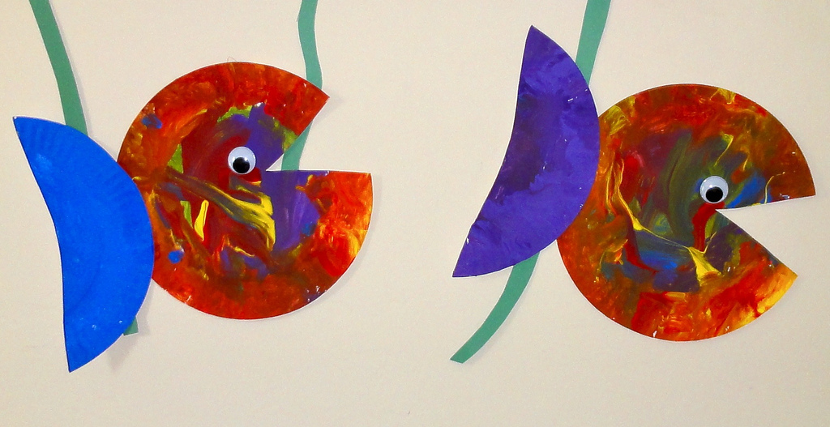

Cognitive Development in Childhood
[Professor Name]
[Class Section Number]
Notes:
Cognitive Development is ideally taught over two class periods, as there is some extra material that can be incorporated into this chapter for a more comprehensive understanding of cognitive development. It can also be taught over 1 class period. Class design suggestions are below
Two class periods:
1st class period (50 min – 75 min):
Introduction to development
Talk about the different types of development. The three covered in the modules are cognitive, social, and aging.
Nature vs. nurture
Continuous or discontinuous development
Piaget
2nd class period (50 min – 75 min):
Applications to educations
Research methods with young children
Habituation
Optional: Extra topics
Sociocultural theory (Vygotsky)
Information processing theory (Klar)
One class period:
1st class period (50 min – 75 min):
Introduction to development
Emphasis on cognitive development, talk about other types of development
Nature and Nurture
Continuous vs. discontinuous development
Piaget
Applications to education
Research methods with young children

Slide 2
Overview
Introduction
Nature vs. Nurture
Continuous and Discontinuous Development
Piaget’s Stages of Development
  Activity
Application to Education
Activity
Notes:
The purpose of this slide is to provide students with an overview of the material that will be covered during the lecture.
Technical Note: These slides may contain simple click animation so that you can focus students’ attention on a particular question, a selection of text, or an image and not have them be distracted by reading ahead. You can either preview the sequence of animation by going through the slides in slideshow view, visiting the animations tab, or reviewing the slide notes. In the notes you will see a cue - (Click) – that corresponds to each animation.
You will also find hyperlinks to outside videos at various places in the slides. These hyperlinks are embedded in text and indicated by color and in the notes section.

Slide 3
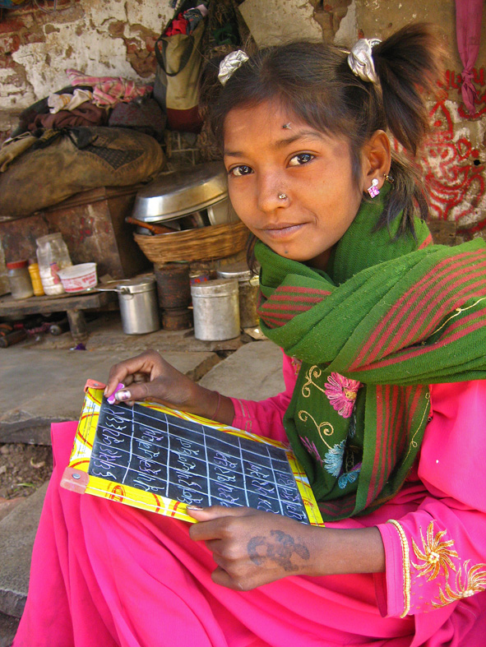
Introduction
Development?
How to study it?
Stages or continuous?
Notes:
This slide is meant to increase students’ interest in development and aid them in beginning to think critically about all aspects of development over the course of a lifespan.
Begin by asking students to volunteer answers to the following questions and provide reasons that support their answers.
(Click) Development
How do we define development?
(Click) How to study it?
What are some ways psychologists study development?
(Click) Stages or continuous?
Does development happen in stages or is it a continuous process?
Instructor’s note: This discussion focuses on cognitive development, specifically stage theory; future lectures will focus on social and personality development, as well as lifespan development.
Development occurs across many domains and at different rates. Cognitive development occurs across a wide span of abilities, including problem solving, reasoning, remembering, perceiving, and understanding and producing language.
3 prominent theories of cognitive development are:
Piaget’s stage theory
Sociocultural theories proposed by Lev Vygostsky emphasizing how people’s attitudes, values, and beliefs influence child development
Information processing theories, such as David Klahr’s, that examine the mental processes that produce thinking at any one time and the transition processes that lead to growth in that thinking
Discussion Question: Ask students to consider the following as the lecture proceeds:
Do children’s natures differ, or do differences among children only reflect differences in their experiences?

Slide 4
Overview
Introduction
Nature vs. Nurture
Continuous and Discontinuous Development
Piaget’s Stages of Development
  Activity
Application to Education
Activity
Notes:
The purpose of this slide is to provide an overview of the material that will be covered in the lecture.

Slide 5


Nature and Nurture
Nature ➔ Biology
Nurture ➔ Environment
The Great Debate
Choices and Decisions
Notes:
This slide introduces the concept of nature and nurture.
Nature refers to one’s genes or heritable traits. Nurture refers to the environment that development occurs in and can include prenatal conditions, as well as social and physical development.
(Click) The Great Debate
The nature-nurture issue has involved a great deal of debate between psychologists for a very long time. We now know that development typically involves an interaction between genes (nature) and environment (nurture). Some aspects of development that initially appeared to be explained by genes (nature), also involve experience (nurture).
Discussion Question: What are some ways nature and nurture might work together to affect development?
Examples:
Depth perception develops as a result of seeing patterned light (nurture) combined with normal brain activity (nature). Without either of these depth perception does not develop.
Similarly, a child’s genetic makeup can elicit consequential responses from the environment; culturally desirable traits (e.g., extroversion, physical beauty) lead to positive responses from people, contrasting with undesirable traits (e.g., irritability, disfigurement).
(Click) Choices and Decisions
Finally, choices and interests of the child throughout development also play a role in cognitive development. For example, the more that children choose to read, the more that their reading improves in future years. Also, parental decisions regarding children’s exposure to specific people and environments have a tremendous impact on development.

Slide 6
Overview
Introduction
Nature vs. Nurture
Continuous and Discontinuous Development
Piaget’s Stages of Development
  Activity
Application to Education
Activity
Notes:
The purpose of this slide is to provide an overview of the material that will be covered in the lecture.

Slide 7
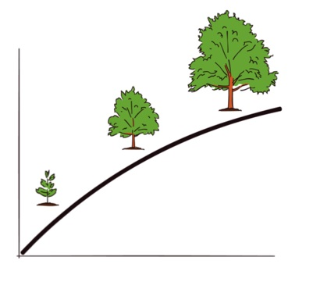
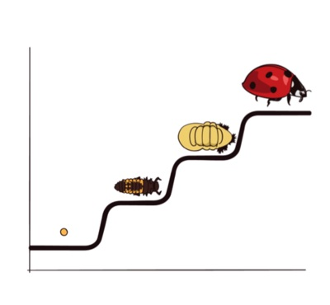
Continuous and Discontinuous Development
What is Continuous Development?
What is Discontinuous Development?
Notes:
This slide illustrates the concepts of continuous and discontinuous development.
Continuous development involves gradual, quantitative changes, whereas discontinuous development involves relatively sudden, qualitative changes. Researchers of cognitive development have begun to ask if such distinctions may characterize changes in children’s thinking.
(Click) What is Continuous Development?
Ask students to provide examples of continuous development.
(Click) Illustration of tree’s gradual development over time
(Click) What is Discontinuous Development?
Ask students to provide examples of discontinuous development.
(Click) Illustration of ladybug’s sudden development
Explanation: Here the tree has grown incrementally, according to the mode of continuous development; the ladybug, however, has completely changed its form at various stages of its life cycle, according to the mode of discontinuous development.

Slide 8
Overview
Introduction
Nature vs. Nurture
Continuous and Discontinuous Development
Piaget’s Stages of Development
  Activity
Application to Education
Activity
Notes:
The purpose of this slide is to provide an overview of the material that will be covered in the lecture.

Slide 9
Piaget’s Theory of Cognitive Development
Sensorimotor Stage
Preoperational Reasoning
Concrete Operational
Formal Operational
Birth to 2 Years
2 to 6 or 7 Years
6 or 7 to
11 or 12 Years
11 or 12 - Lifetime
Intelligence in action: child interacts with environment by manipulating objects; object permanence
Thinking dominated by perception, but child becomes more capable of symbolic functioning; conservation problem; language development occurs
Logical reasoning only applied to objects that are real or can be seen
Individual can think logically about potential events or abstract ideas; advanced reasoning
Notes:
This slide illustrates Piaget’s theory of cognitive development through stages.
Instructor’s note: The slide provides a brief overview of each stage as you cycle through, with demonstration opportunities for stage-associated tasks/problems and video examples at each click (For detailed instructions of the “Demonstration of Piaget’s Classic Tasks” see IM > Unit Development > Module 1: Cognitive Development in Childhood > Activities/Demonstrations.)
(Click) Sensorimotor Stage
Demonstrate the concept of object permanence by showing and then hiding a book. Then ask students if the book still exists. (This exercise will be obvious to them.) Please note that the next slide in this presentation contains a video on object permanence.
Click the “Sensorimotor Stage” link to play the video demonstrating the object permanence task.
Discussion question: How are your expectations of the book different from that of the children in the video, and why?
(Click) Preoperational Reasoning
Demonstrate the concept of conservation using coins first in two stacks and then spread out on a table. Ask students if the spread out coins are the same in number as the stacked coins. (This exercise will be obvious to them.)
Click the “Preoperational Reasoning” link to play the first video demonstrating the conservation task.
Discussion question: Why aren’t the children in the video able to successfully answer the conservation questions but you are?
(Click) Concrete Operational
Explain that by this stage of development, children’s thinking is complex enough to master the conservation task.
Click the “Concrete Operational” link to play the second video demonstrating the conservation task.
Discussion question: What has changed about the children who can now successfully complete the conservation tasks?
(Click) Formal Operational
Demonstrate the concept of formal operational by asking the class to consider this hypothetical scenario: Suppose that from this moment on every human baby is born with only one leg; how would society have to change? Students should be able to formulate a variety of real-world adjustments such as new modes of transportation, fashion, etc.
Click the “Formal Operational” link to play the video demonstrating the distinction between the concrete and formal operational stages.
Discussion questions: How does the one-leg scenario relate to the example of formal operational shown in the video? How are both of these examples of formal operational cognitive development? What is the distinction between the concrete and formal operational stages?
Further explanation: Keep in mind that Piaget’s theories are still debated and researchers have had divergent outcomes, particularly between various cultures, that seem to suggest a more continuous development that Piaget imagined. Cultural diversity also appears to affect the full realization of complex reasoning described by the formal operational stage.

Slide 10
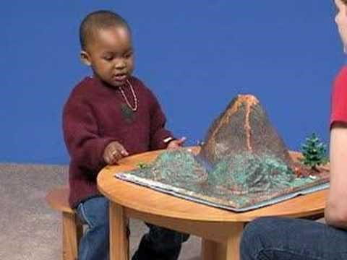
Object Permanence
Notes:
This video depicts a demonstration of “object permanence,” (the ability to remember and understand the existence of an object even if it is out of sight).
You may choose to engage students in a discussion following this video by asking questions such as:
Do dogs have object permanence? How would we know?
Answer: Dogs show some ability for object permanence but not as much as humans. Even controlling for their sense of smell some dogs can use visual clues to help locate an object that has been moved. See this article for a specific research example: http://www.uky.edu/~zentall/pdfs/article%20object%20perm.pdf
2. What do you think the benefit of object permanence is? How does this ability help humans function?

Slide 11
Overview
Introduction
Nature vs. Nurture
Continuous and Discontinuous Development
Piaget’s Stages of Development
  Activity
Application to Education
Activity
Notes:
The purpose of this slide is to provide an overview of the material that will be covered in the lecture.

Slide 12
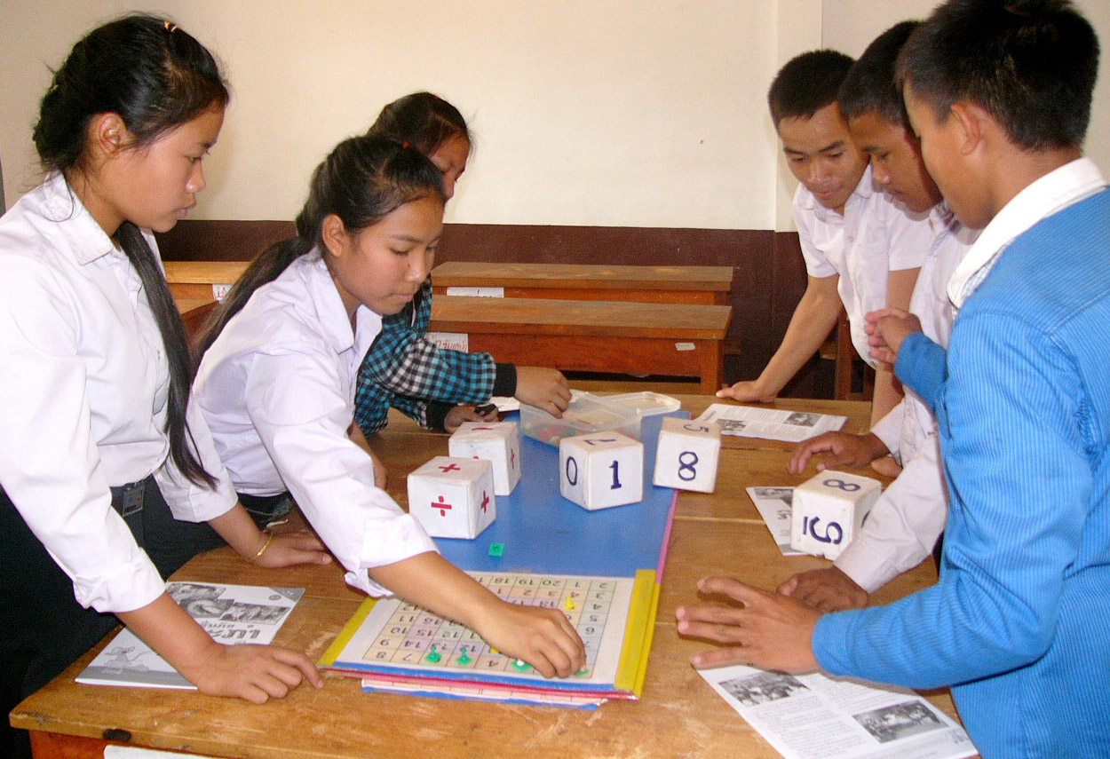
Applications to Education
Nurture
Reading
Mathematics
Nature
Brain Activity
Notes:
This slide focuses on the educational implications of research into cognitive development.
Understanding how the interaction of nature and nurture shapes children’s thinking has been demonstrated to have real-world, practical benefits:
Nurture:
One example is the understanding of the role that phonemic awareness—awareness of the component sounds within words—plays in reading. Specifically, fostering phonemic awareness has been shown to be a better predictor of reading achievement than IQ or social class.
In addition to skills that can be explicitly taught and measured (e.g., phonemic awareness), activities such as playing numerical board games, (e.g., Chutes and Ladders, which requires the use of dice, numbered spaces, etc.) have been shown to improve children’s comprehension of numerical magnitudes (the sizes of numbers).
Nature:
Contrary to some people’s belief that brain maturation occurs before birth, the brain actually continues to develop for many years, into early adulthood. For example, a part of the brain called the prefrontal cortex, which is particularly involved with planning and flexible problem solving, continues to develop throughout adolescence.
Discussion questions: Returning to the question posed in the introduction—Do children’s natures differ, or do differences among children only reflect differences in their experiences?—how have students’ views changed during the course of the lecture? How might other possibilities for understanding cognitive development be important to education?

Slide 13
Overview
Introduction
Nature vs. Nurture
Continuous and Discontinuous Development
Piaget’s Stages of Development
  Activity
Application to Education
Activity
Notes:
The purpose of this slide is to provide an overview of the material that will be covered in the lecture.

Slide 14


Activity
Habituation
5
Volunteers
Notes:
The purpose of this activity is to demonstrate the concept of habituation.
Instructor’s note: For this activity you will need a push pin and 6 balloons blown up before class. One balloon should have an X of tape on it (students should NOT be informed of or shown the X beforehand). For detailed instructions of the “Habituation as a method for understanding cognition in young children” see IM > Unit Development > Module 1: Cognitive Development in Childhood > Activities/Demonstrations.
Introduce the activity by explaining that, while infants may have extremely limited cognitive abilities, very young infants are constantly observing their environments in order to habituate themselves. After only a few months of age, infants tend to have basic expectations of continuity in their environments. Infants tend to stare longer and show a decreased sucking rate (a measure of interest in young infants and children) when presented with the unexpected.
Explanation:
Habituation is familiarity with a stimulus; as we are exposed to a stimulus repeatedly, our interest in it generally wanes and our responses become predictable.
Dishabituation is an increased response to new stimulus; when a stimulus is new to us, our attention is drawn to it. If we have become habituated (bored), and attention is renewed, then we have dishabituated to the new stimulus.
Activity:
Ask for 5 volunteers to line up and each hold a balloon and pop it. Now it’s your turn to surprise everyone: Insert the push pin into the hidden X on the 6th balloon, which, if done correctly, should deflate slowly instead of popping. By now the students will have become habituated to the popping of the balloons, likely cringing or plugging their ears.
Discussion questions: How did the students react or feel when the last balloon didn’t pop? What did they observe about the reactions of their classmates? How do they think observing children reacting to such stimuli might inform their own thinking?
Further Suggested Discussion Topics: Ask students how they would set up experiments with children (reminding them that you have seen examples in videos and read about them in the text). Then ask about children who can’t talk yet. We know how they react in certain situations, but how do we know what they are thinking?

Slide 15
Photo Attribution
Slide 1 | Photo Credit: Mindful One https://www.flickr.com/photos/99173376@N00/6009496454/ https://creativecommons.org/licenses/by-nc-nd/2.0/
Slide 2 | Photo Credit: Instagram: Brunobrunan https://www.flickr.com/photos/13956722@N06/12652652773/ https://creativecommons.org/licenses/by/2.0/
Slide 5 | Photo Credit: Caroline Davis2010 https://www.flickr.com/photos/53416677@N08/4973532326/ https://creativecommons.org/licenses/by/2.0/
Slide 5 | Photo Credit: taod https://www.flickr.com/photos/51774067@N00/23658571/ https://creativecommons.org/licenses/by-nc-sa/2.0/
Slide 12 | http://commons.wikimedia.org/wiki/File:Math_games_-_Big_Brother_Mouse_activity_day.jpg http://creativecommons.org/licenses/by-sa/3.0/deed.en
Slide 14 | Photo Credit: Wolfram Burner https://www.flickr.com/photos/29036545@N00/7312534440/ https://creativecommons.org/licenses/by-nc/2.0/
Slide 14 | Photo Credit: theothernate https://www.flickr.com/photos/8857416@N04/6816751340/ https://creativecommons.org/licenses/by-nc/2.0/

